Slide 1


Infrastructure As Code
with

Slide 2


About me
I am DevOps Engineer at Vivial Dominicana, passionate about everything related to Open Source, practitioner in the art of sharing and smiling at life in all its moments and forms.
@WilkinsOrtiz4 github.com/Wilkins089

Slide 3
Traditional infrastructure...

Slide 4
Infrastructure as a Service (iaas)

Slide 5
What is IaC?

Slide 6
What is IaC?
“...the practice of treating infrastructure as if it were code.” Carl Caum - Puppet
“...the process of managing and provisioning computer data centers through machine-readable definition files...” A lot of people - Wikipedia

Slide 7
So… Why?

Slide 8


FIRULAIS
AWS Console

Slide 9

FIRULAIS
AWS Console
EC2

Slide 10

RDS
FIRULAIS
AWS Console
EC2

Slide 11

RDS
FIRULAIS
AWS Console
EC2
S3

Slide 12

RDS
FIRULAIS
AWS Console
EC2
S3
AWS Cloudfront

Slide 13

RDS
AWS ELB
FIRULAIS
AWS Console
EC2
S3
AWS Cloudfront

Slide 14
RDS
EC2
EC2
EC2
FIRULAIS
AWS Console
EC2
S3
AWS Cloudfront

Slide 15


Slide 16
But… Is this for me? Does it deserve my time?

Slide 17
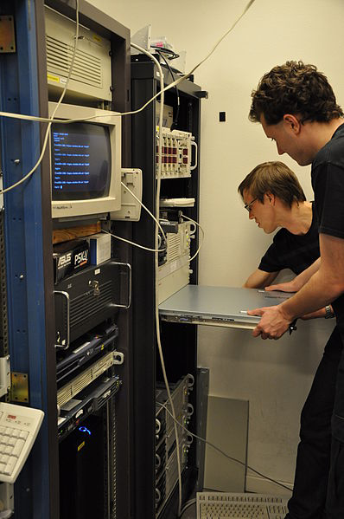
Is your provisioning fast enough?

Slide 18
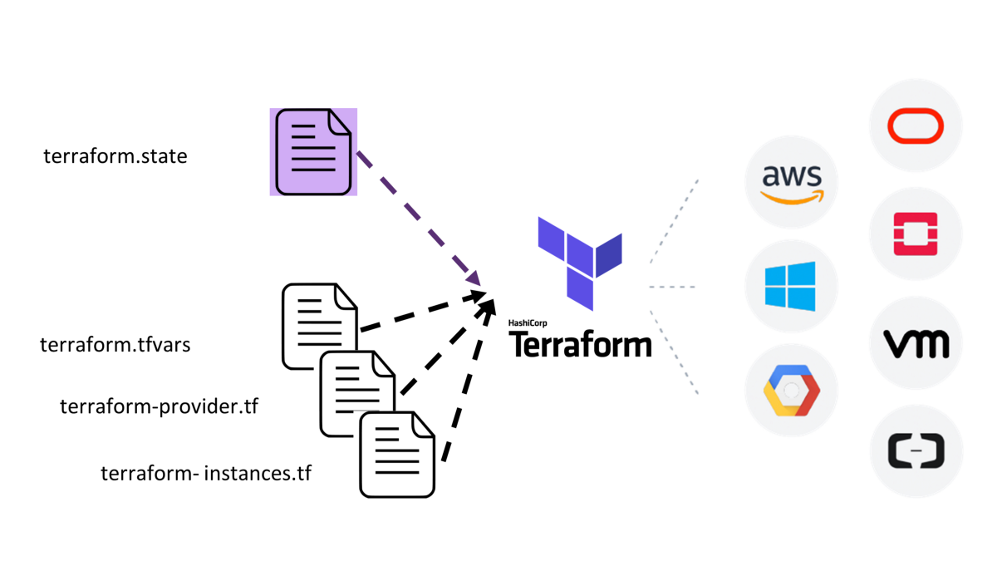

Slide 19
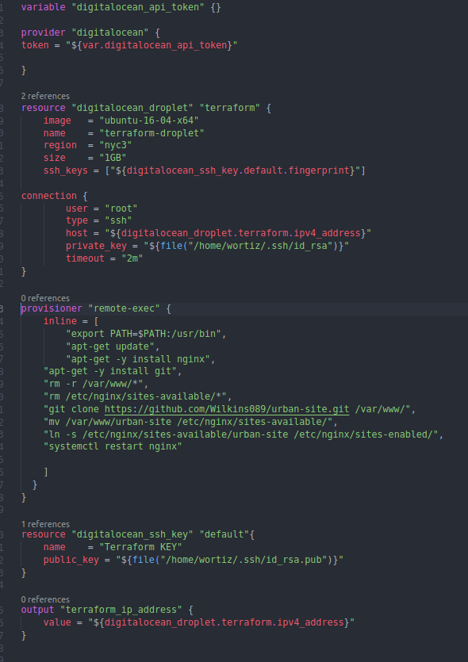
do_terraform.tf:

Slide 20

Talk is cheap.
Show me the code.
(Linus Torvalds)

Slide 21
